Slide 1

HOTEL BOOKING SYSTEM
PHP, MYSQL PROJECT
-------------------NISHANTH D KINI

Slide 2
It is a HOTEL BOOKING WEBSITE where you can search for a particular room whether
its single or double and then enter into the main page where you can book the particular
the room you have chosen by giving all your details and then the particular entry gets stored
in the administrator’s database and then in another Case, you can also add a new room
by uploading an image and giving a particular text and that too gets stored in the database
- NISHANTH D KINI

Slide 3
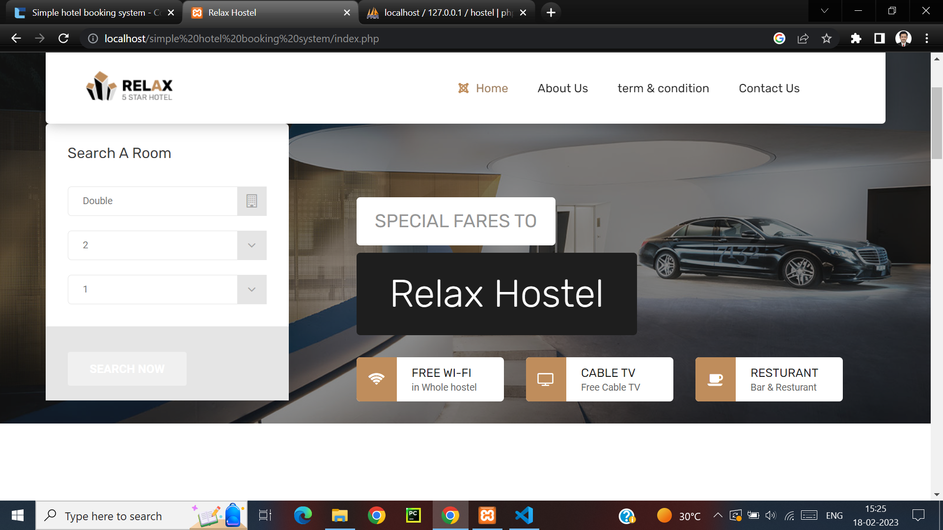
THIS IS THE MAIN PAGE WHERE YOU CAN SEARCH FOR THE ROOM OF YOUR CHOICE

Slide 4
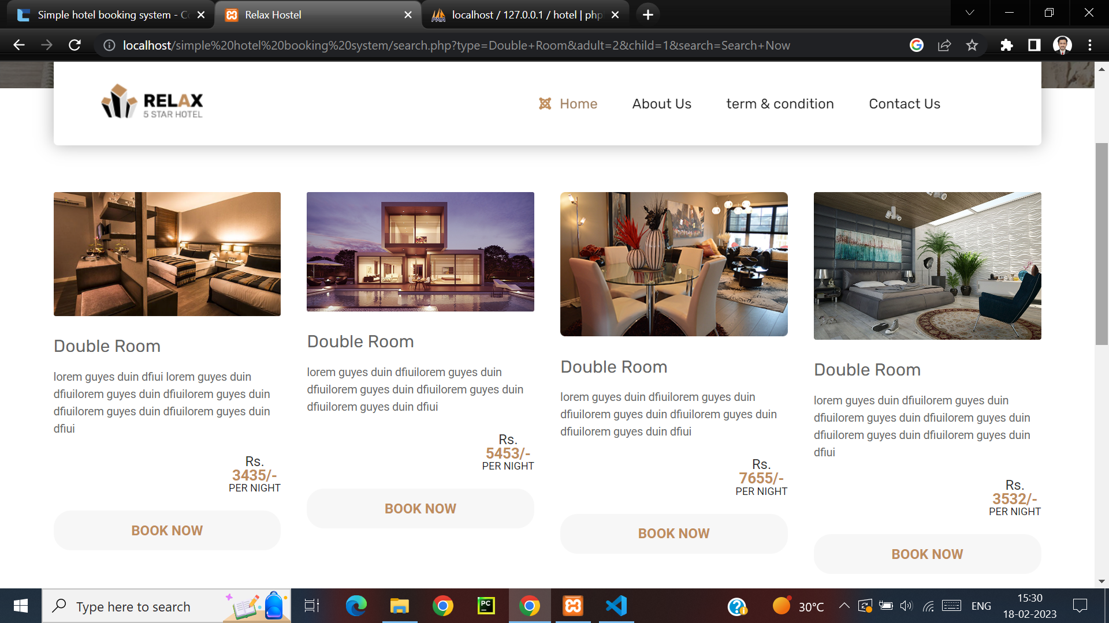
THE ROOM U ENTERED IS SHOWN

Slide 5
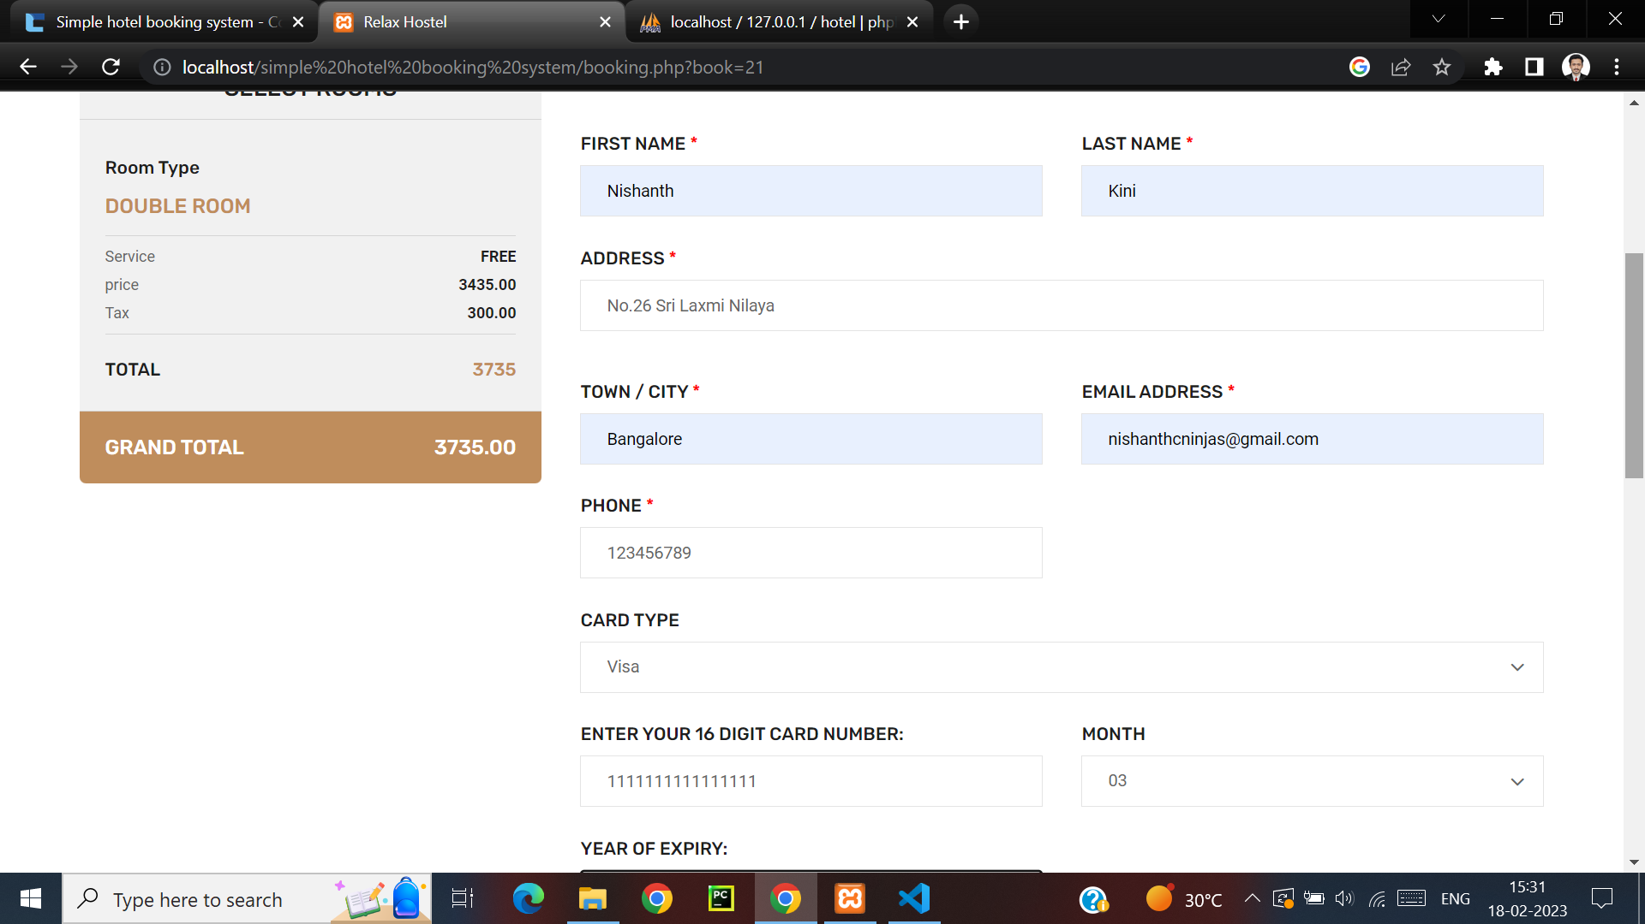
DETAILS HAS TO BE GIVEN FOR THE ROOM WHICH IS CHOSEN AND BILLING IS DONE

Slide 6
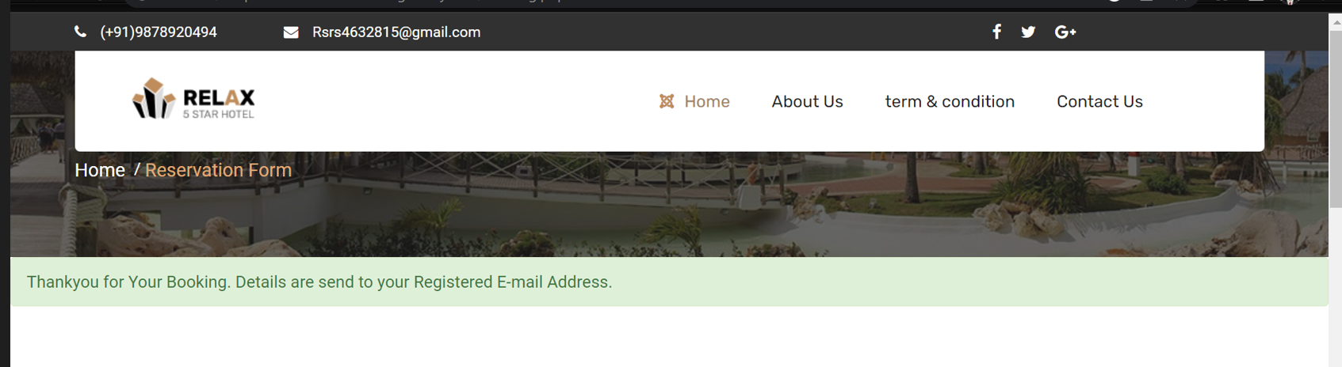
ON SUCCESSFUL BOOKING

Slide 7
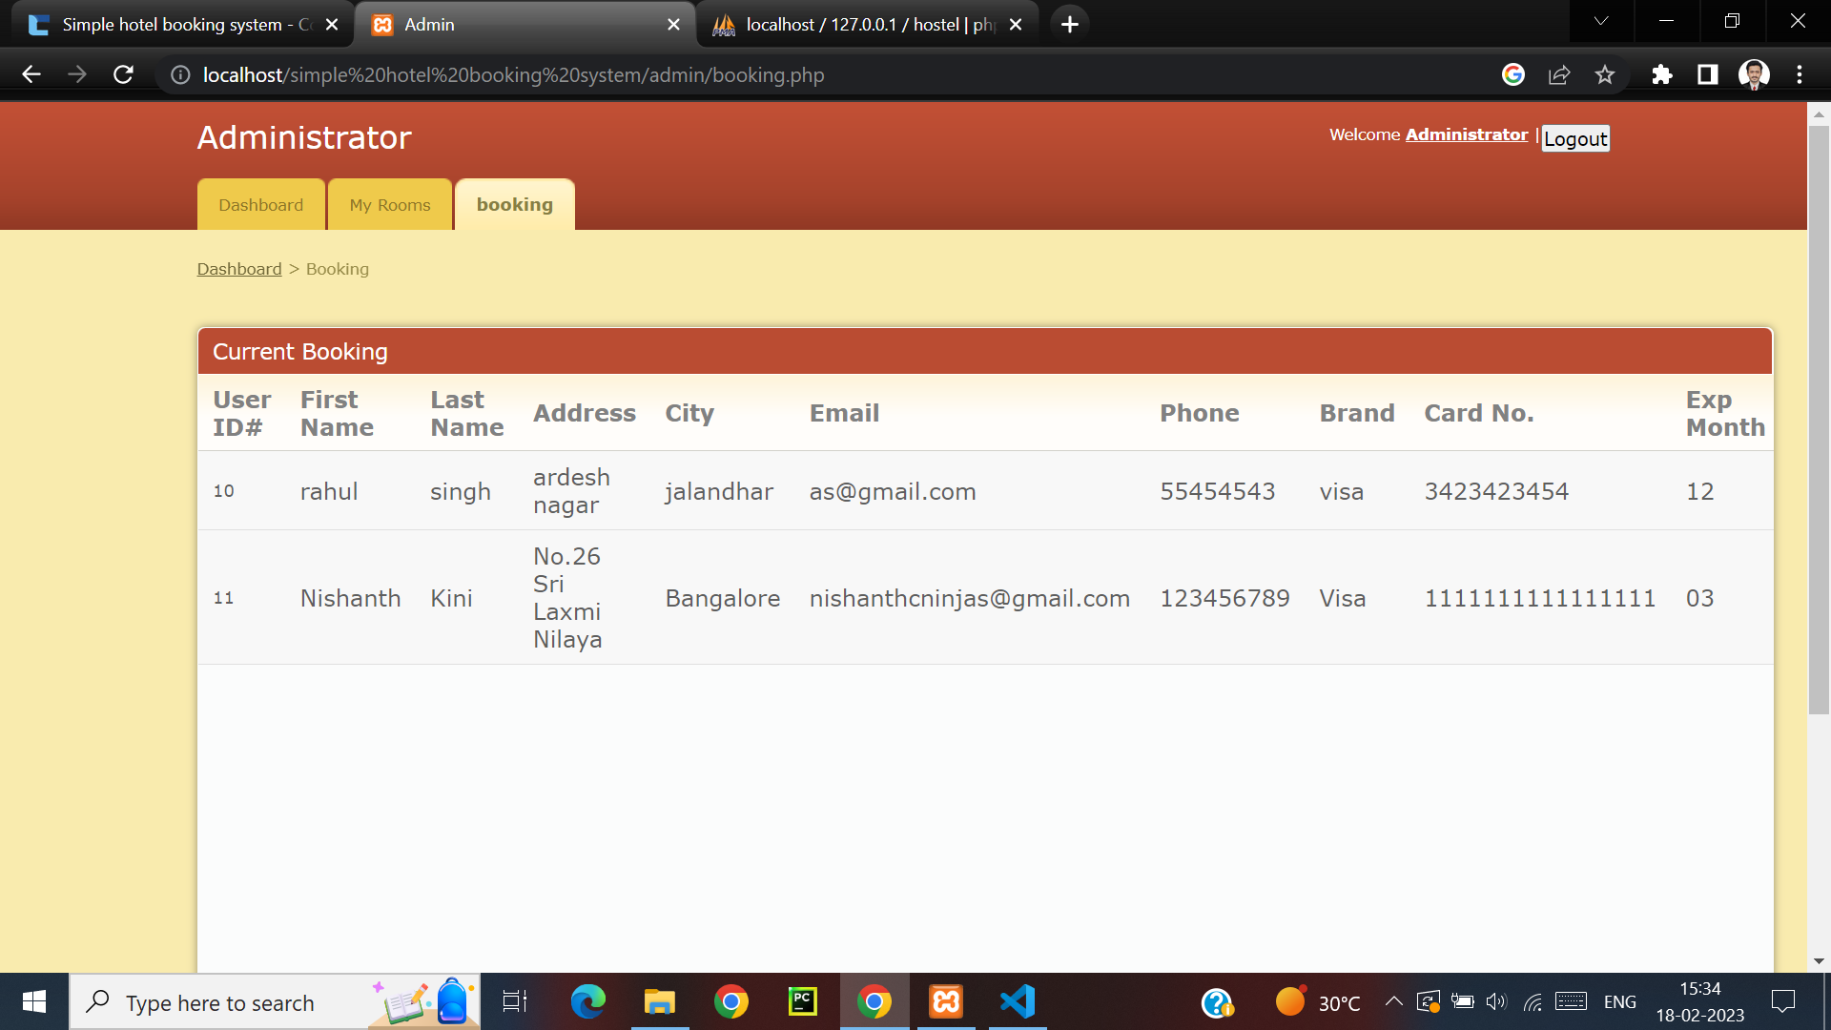
THE DETAILS WHAT U GAVE WILL BE ENTERED IN THE ADMIN’S DATABASE

Slide 8
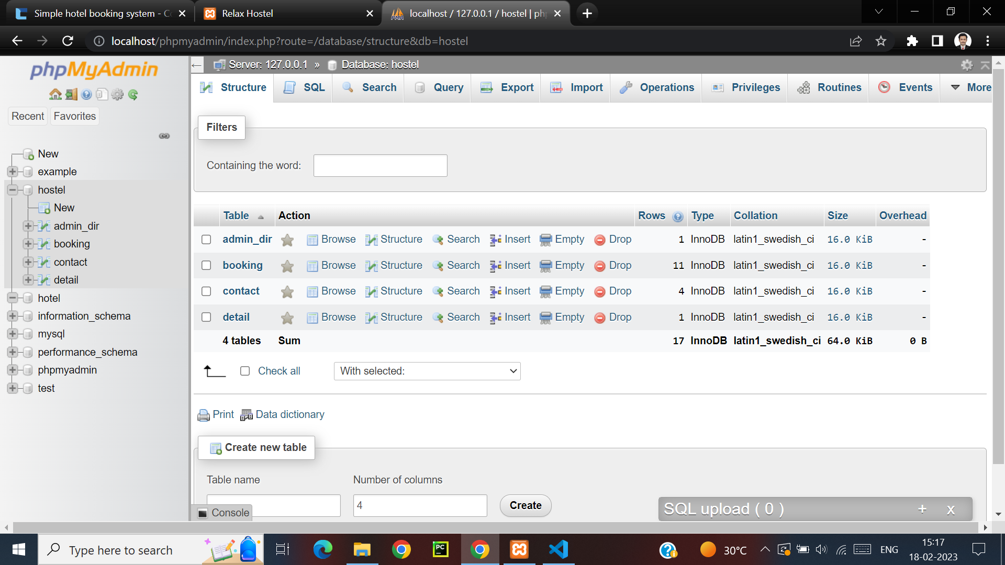
THE MYSQL PART

Slide 9
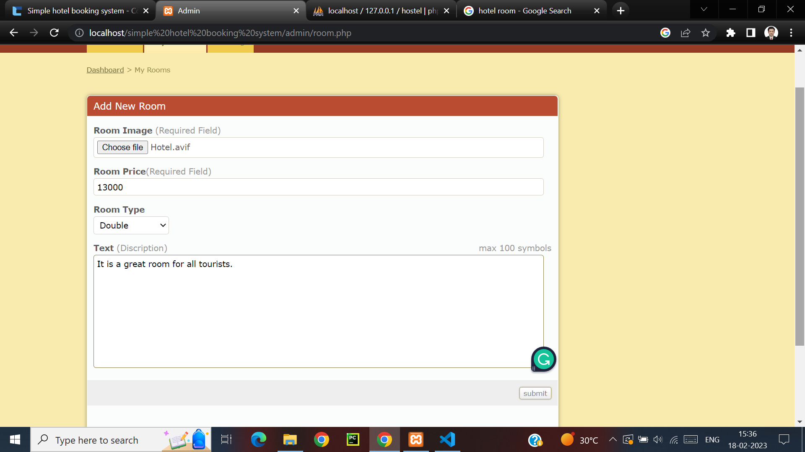
ADDING A NEW ROOM BASED ON USER CHOICE

Slide 10
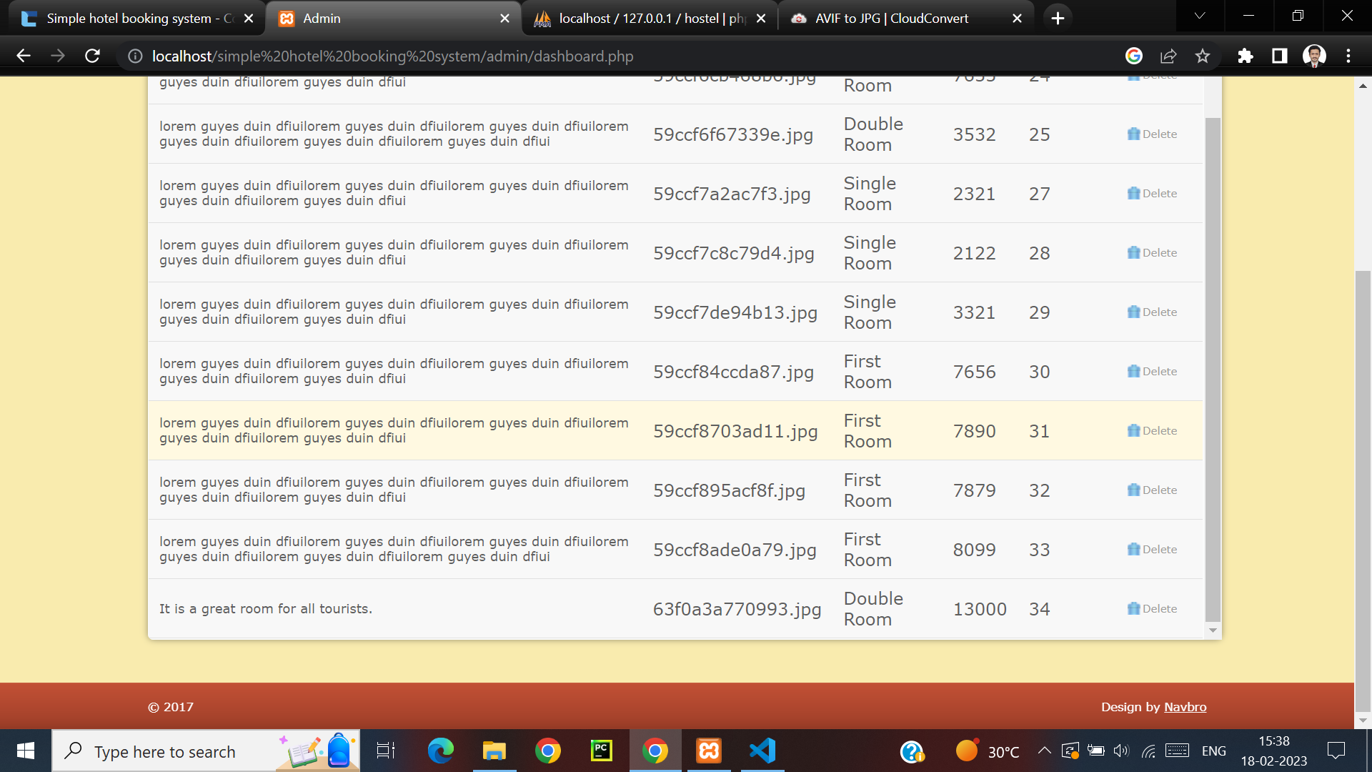
ON SUCCESSFUL ADDING OF A NEW ROOM

Slide 11
THANK YOU

